Slide 1

Sprocket Central Pty Ltd
Data analytics approach

Slide 2
Agenda
Introduction
Data Exploration
Model Development
Interpretation

Slide 3
Introduction
Customer Analysis
Gender distributions
Age distributions
Number of bike purchases in 3 years / percentages purchases
Job industry category
Wealth segments
Number of cars own on each states

Slide 4
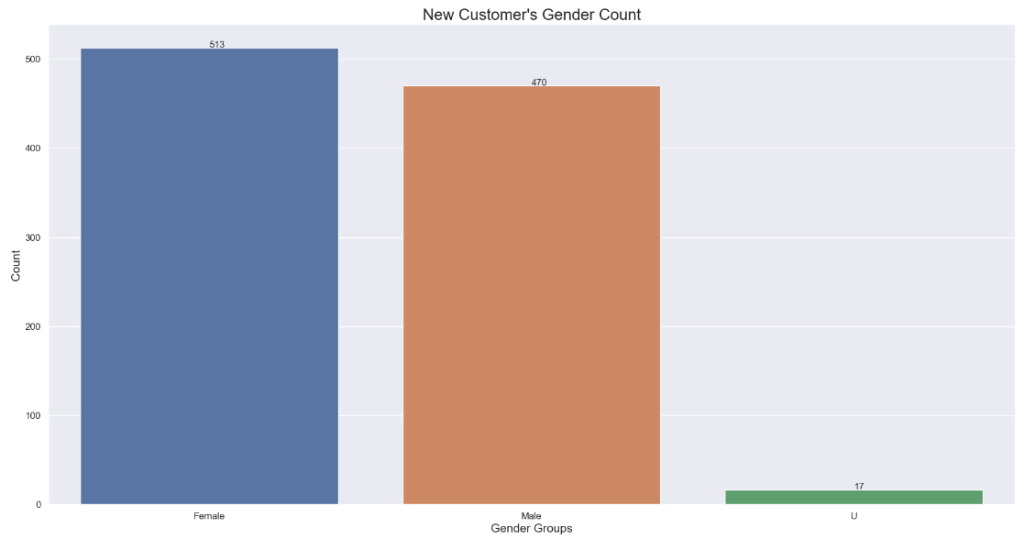
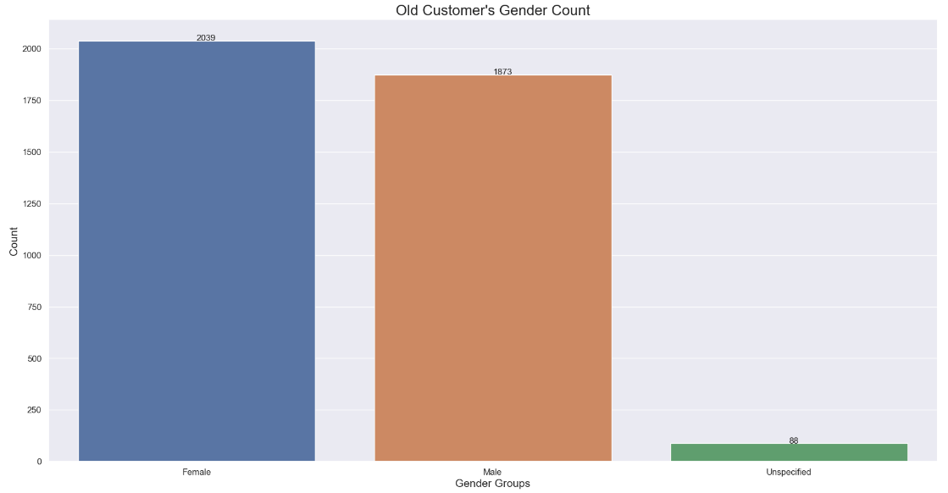
Data Exploration
Customers’ Gender Distribution
As we can see, mostly our new customers as well as our old customers are Female.
Number of Female customers in new data is 513 and Males are 470.
Number of Female customers in old data is 2039 whereas there are 1873 Males.
Our frequent and popular shoppers tend to be women.
We should focus on Female customers as they bring more business to the company and are profitable to us.

Slide 5
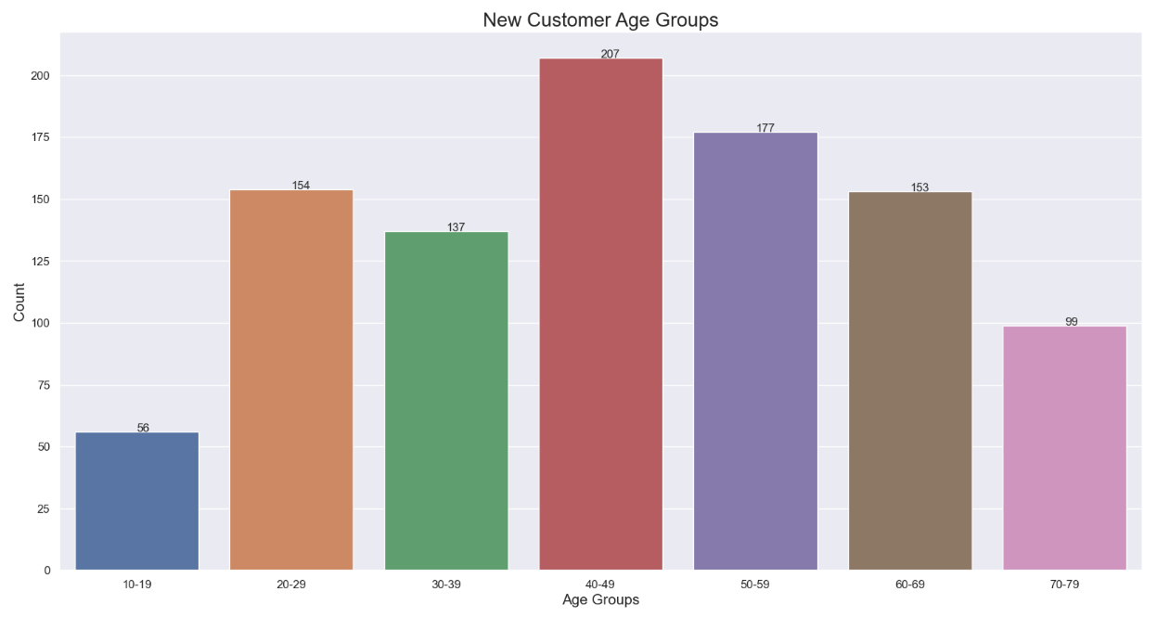
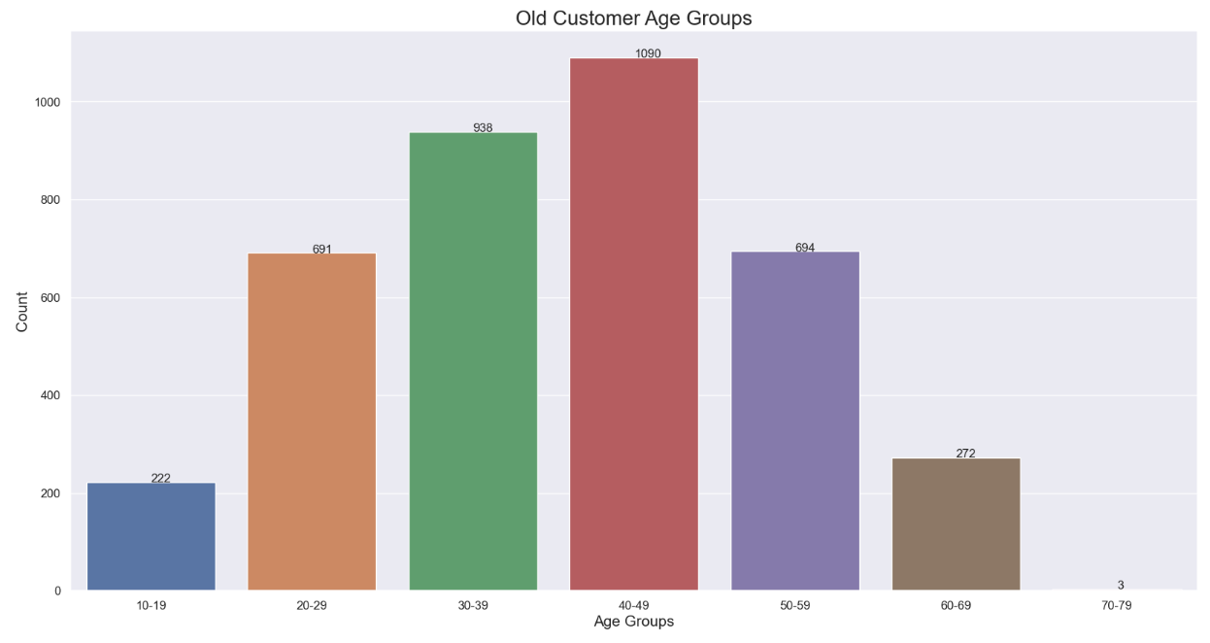
Data Exploration
Customers’ age distribution
As we can see, mostly our new customers are between 40 to 49 years old age group.
Number of customers from 60 to 69 years old has big drops on percentages.
The least popular groups are 10 to 19 and 70 years old and above.
Popular shoppers tend to be between 20 to 69 years old.
Customers aged 70 and above are negligible in the old customer data but have increased in the new customer’s dataset.

Slide 6
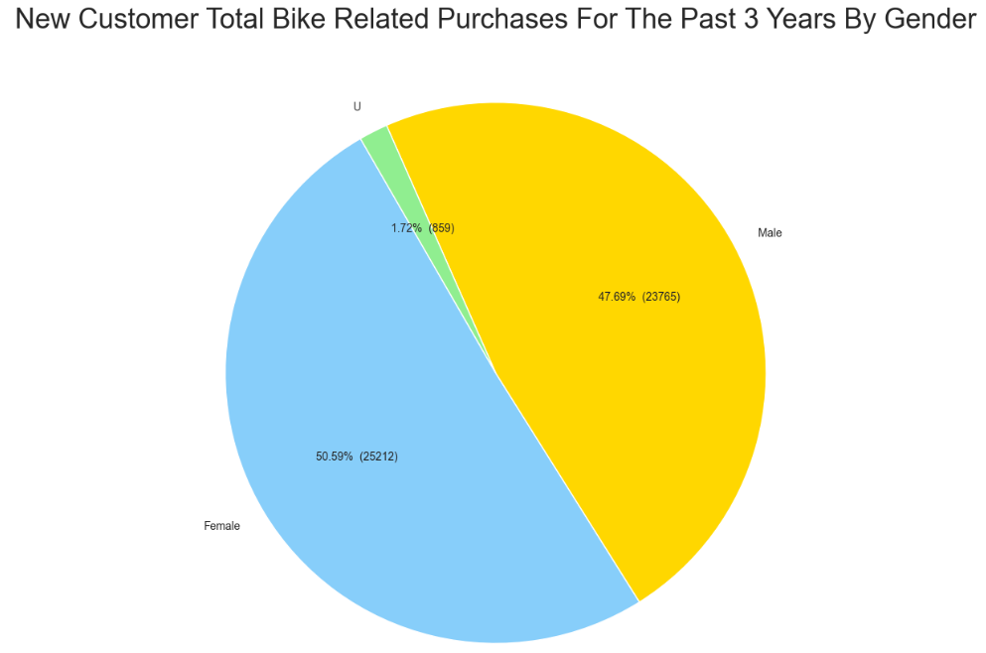
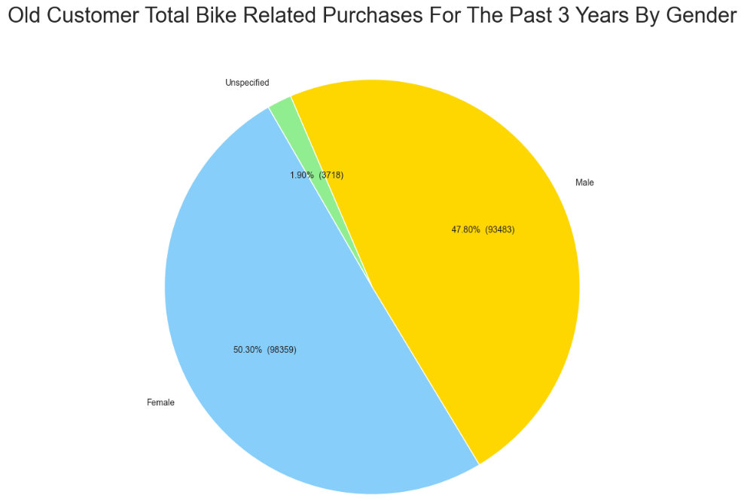
Data Exploration
Bike Purchases in the past 3 years by Gender
Customer gender demographic evenly spread between male and females as per new and old data.
Females make up majority of the bike purchases in the past three years in both new and old customers.
As we can see, our new customers mostly Female with 50.6% purchases with total of 25,212 bikes.
Male contributed to 47.7% purchases with 23,765 bikes as per the new data.
So, we should focus our advertisements on Female customers more than Male customers. They should be more Female centric and relatable to them.

Slide 7
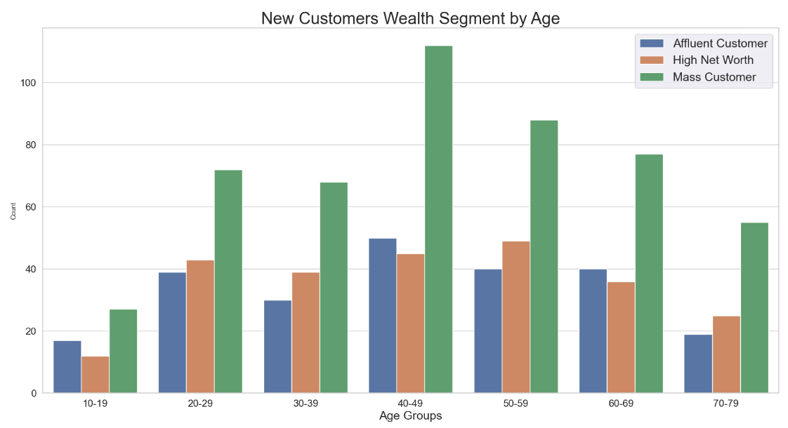
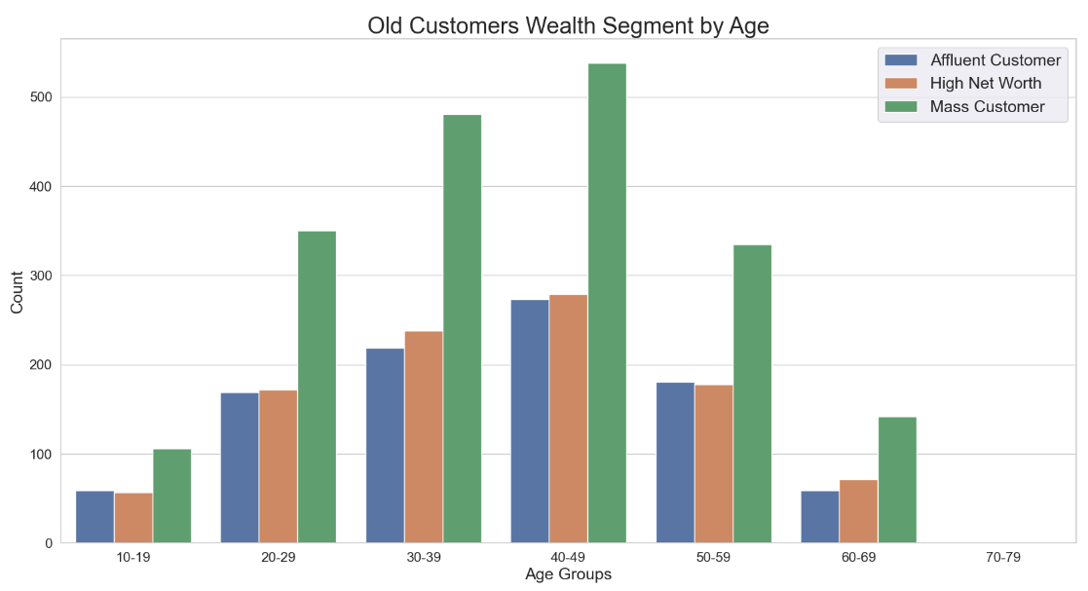
Data Exploration
Wealth Segmentation By Age
Most customers are labelled as Mass Customers in both new and old customer’s data.
More customers labelled as High Net Worth than Affluent by a small margin.
In all ages, the number of Mass Customers is the highest so we should focus on this social class. And it is maximum in the 40-49 age group.
After that, we should focus on High Net Customers and then on Affluent Customers.

Slide 8
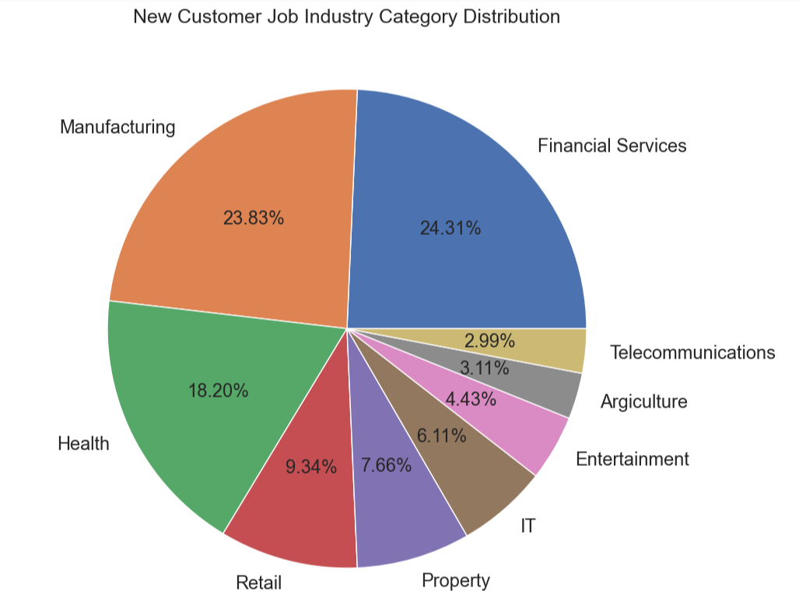
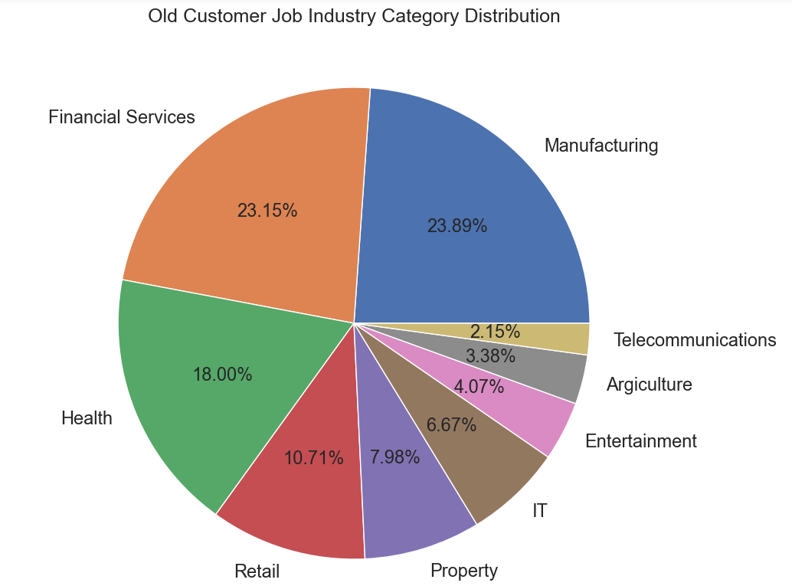
Data Exploration
Job Industry Distribution
Top three profit generating job industries that customers work in are Financial Services, Manufacturing, and Heath for both new and old customers, followed by Retail and Property.
But a greater number of new customers are involved in Financial Services whereas there is more involvement in Manufacturing industry by the old customers.
Least popular job industries are Telecommunications, Agriculture, Entertainment, and IT.

Slide 9
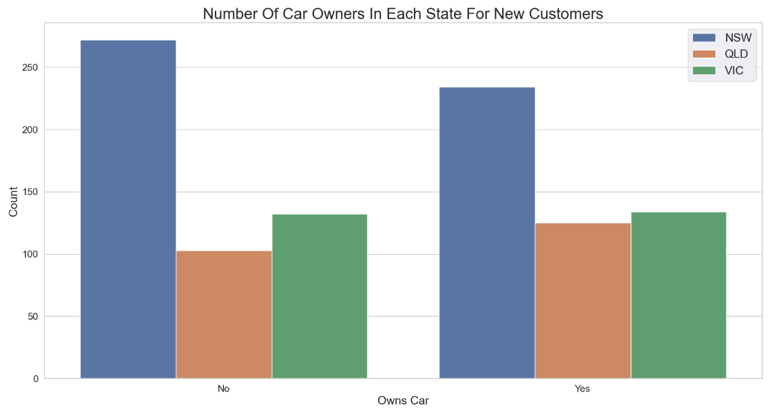
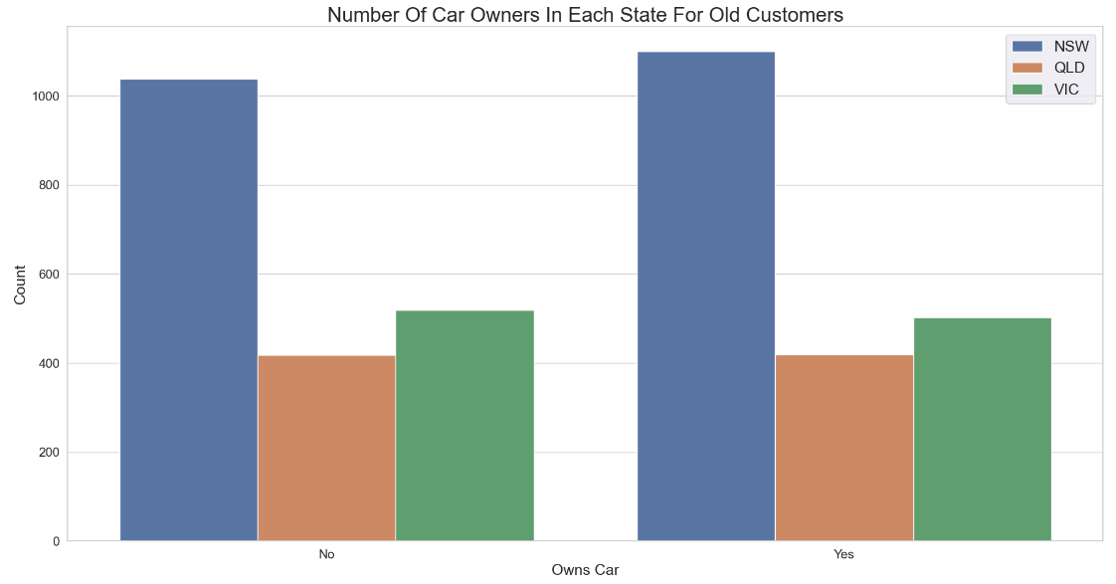
Data Exploration
Car Ownership By State
As per new and old customer’s data the results are quite similar.
Most customers from New South Wales (NSW) don’t own a car in the new data so we could allocate more resources on the NSW region, out of three states as it could be our potential site, indicating that there is room for value customers to make more sales of bicycles.
VIC and QLD has more customers that own car than those who don’t as per the new data, but we can try to have something so that those car owners will buy bikes.

Slide 10
Model Development
CUSTOMER CLASSIFICATION – Targeting High Value Customers
The following are the high-value clients to target from the new list :
Aged between 40 – 49.
Most of the high value customers are female compared to male.
In all age groups, the number of Mass Customers is the highest so we should focus on this social class.
Working in Financial Service, Manufacturing and Health.
Who are currently living in New South Wales.
Sprocket Central Pty Ltd should optimize their resource allocation for targeted marketing.

Slide 11
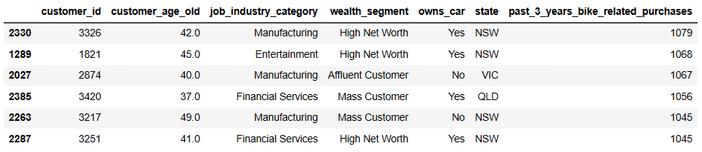
Interpretation
HIGH-VALUE CUSTOMER SUMMARY TABLE

Slide 12
Appendix

Slide 13
Appendix
All supporting items are in this attachment.

Slide 14
THANK YOU

